Slide 1
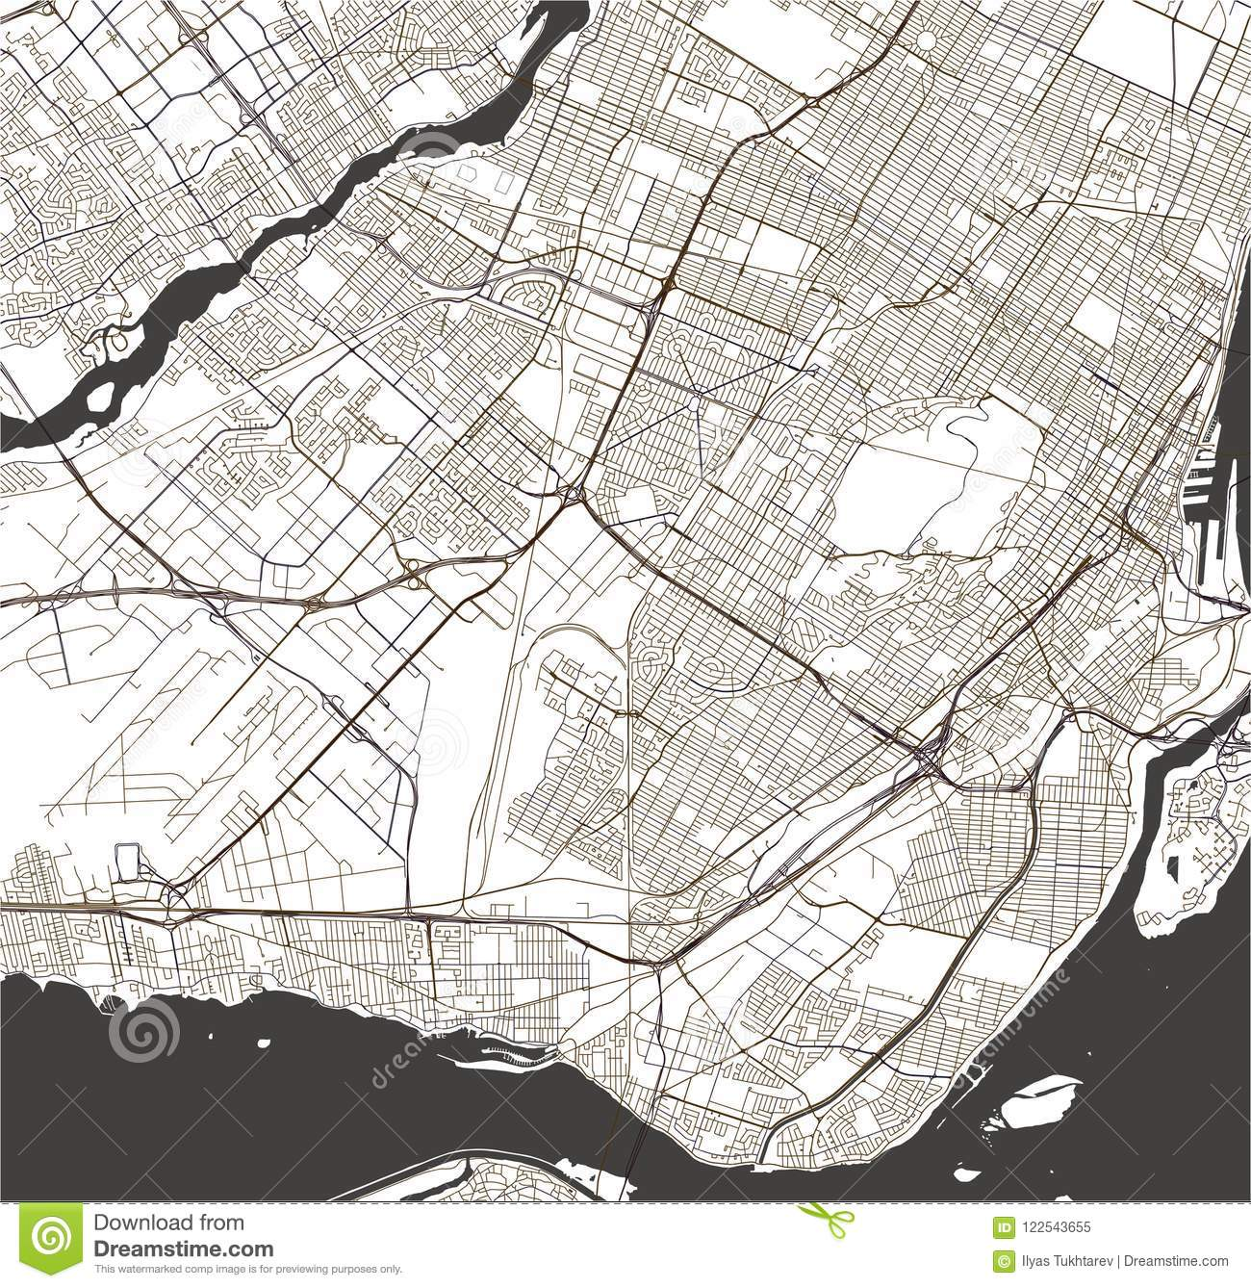

Analysis of Metro Service Incidents in Montreal December 2021

Slide 2
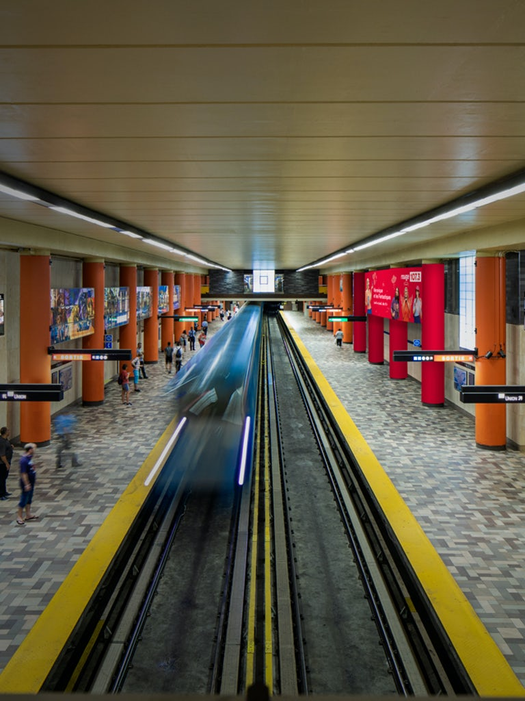
Problem Definition
Question: When is the best time to take the metro? Goal: Identify when and where service interruptions are most frequent by analyzing publicly available data on incidents on the Montreal metro

Slide 3
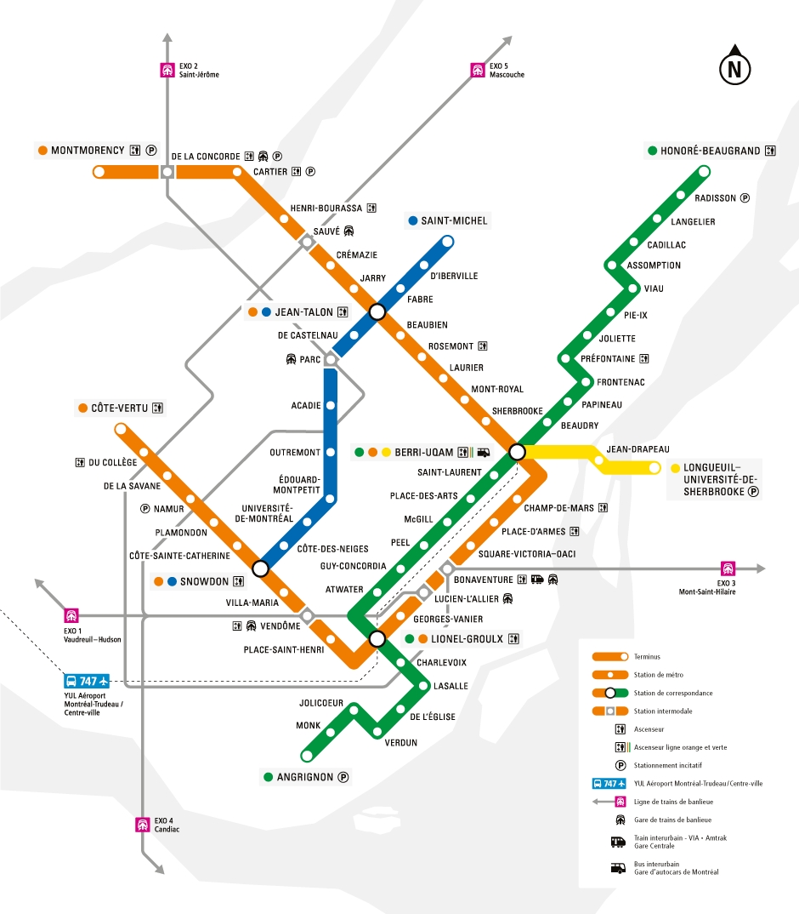
Montreal Metro System

Slide 4
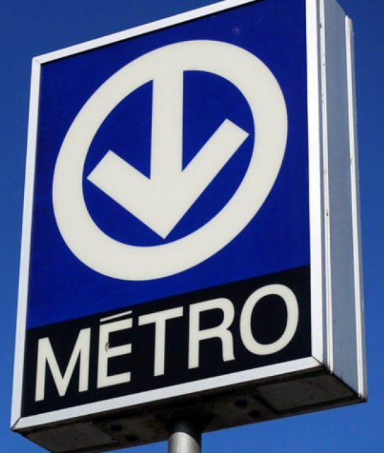
Data Source
Incidents du réseau du métro
https://donnees.montreal.ca/societe-de-transport-de-montreal/incidents-du-reseau-du-metro
Published by the Société de transport de Montréal
Updated monthly

Slide 5
Methodology
Data Cleaning
Data Analysis
Consistent naming
Cleanup of special characters in exported data
Removal of irrelevant data for question (i.e. number of door, vehicle/train type, damage to train)
Accurate time/date data
Coordinate information for stations
Inclusion criteria:
Only incidents classified as ‘train’ vs ‘station’ as ‘station’ incidents don’t affect metro service
Only incidents with interruption of more than 5 minutes
Guidelines for best practices in the public transit industry do not take into account incidents of interruption lasting less than 5 minutes
Focus on 3 main factors:
Location
Time (day, hour)
Incident length
Visualize on tableau

Slide 6
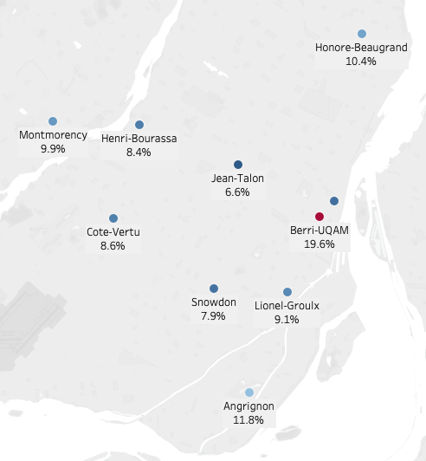
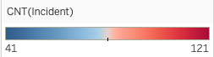
FACTOR #1: LOCATION
Downtown Montreal (McGill and Peel) not in top 10
Top 10 Stations

Slide 7
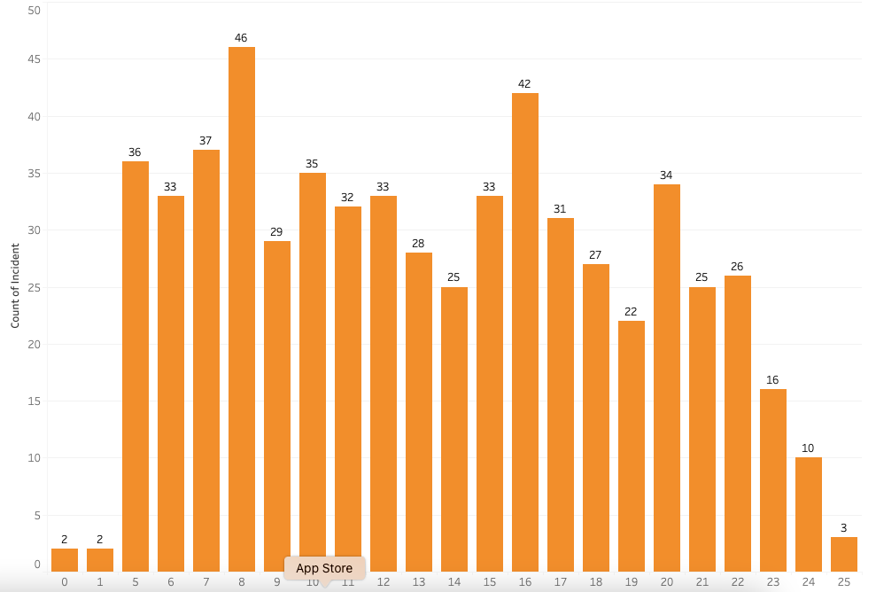
FACTOR #2: TIME OF DAY
Peaks at 8 am, 4 pm, and 8 pm
Drop in incidents after peaks (i.e. 9 am, 5pm, 9 pm)
Incidents By Hour of Day (Top 10 Stations) Note: Metro operating hours are from 5 am - 1 am

Slide 8
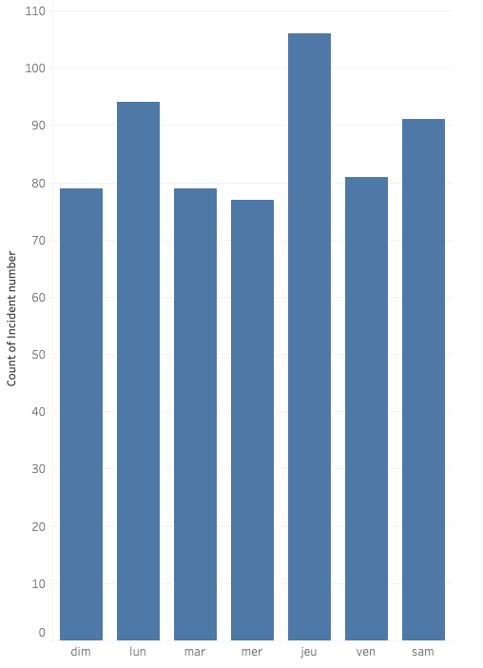
FACTOR #2: DAY OF WEEK
No consistent trend between weekday vs weekend
Incidents By Day of Week

Slide 9
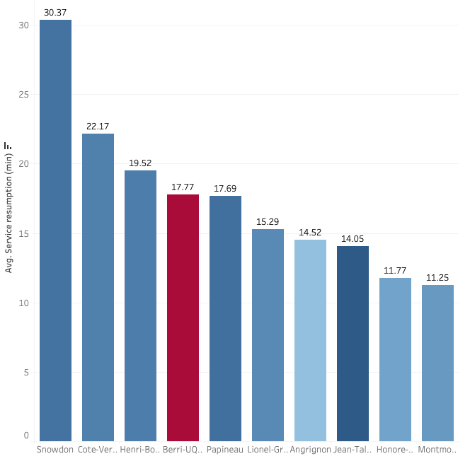
FACTOR #2: INTERRUPTION LENGTH
No trend between length of service interruption and high incident stations
Average Service Interruption Length by Station

Slide 10
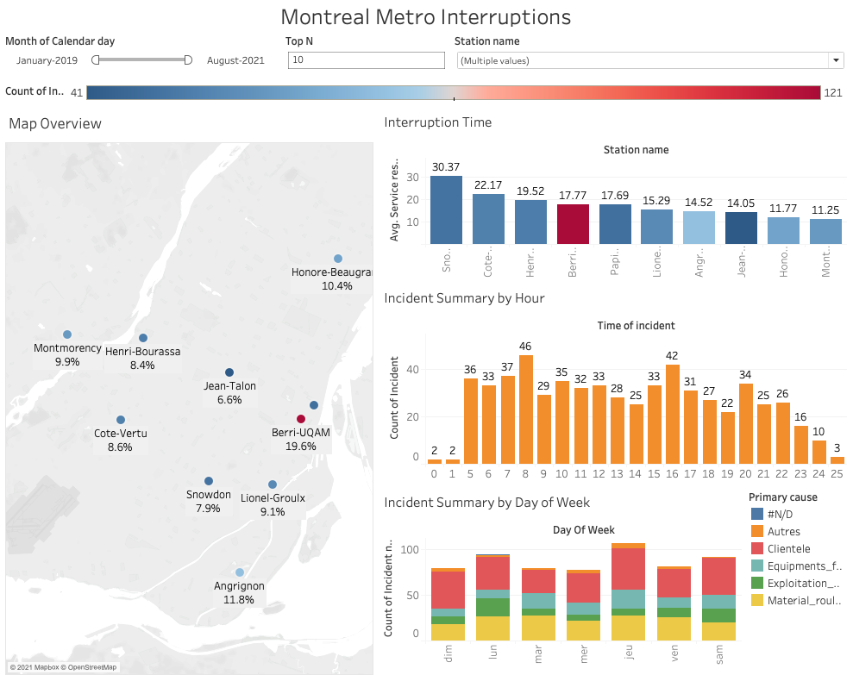
Tableau Dashboard

Slide 11
Conclusion
Time of the day matters more than day of the week
Spike in interruptions generally occur 3 times per day - at 8am, 4pm, and 8pm
Location of the city (i.e. proximity to downtown core) is not a determining factor; location of the station in relation to the line route shows more results
Terminus stations (stations at the end of lines) comprise 4 of the top 5 incident stations
Stations serving as transfer stations (those that have at least 2 different lines) likely to have more incidents
No particular trend between average length of interruption and high-incident stations

Slide 12
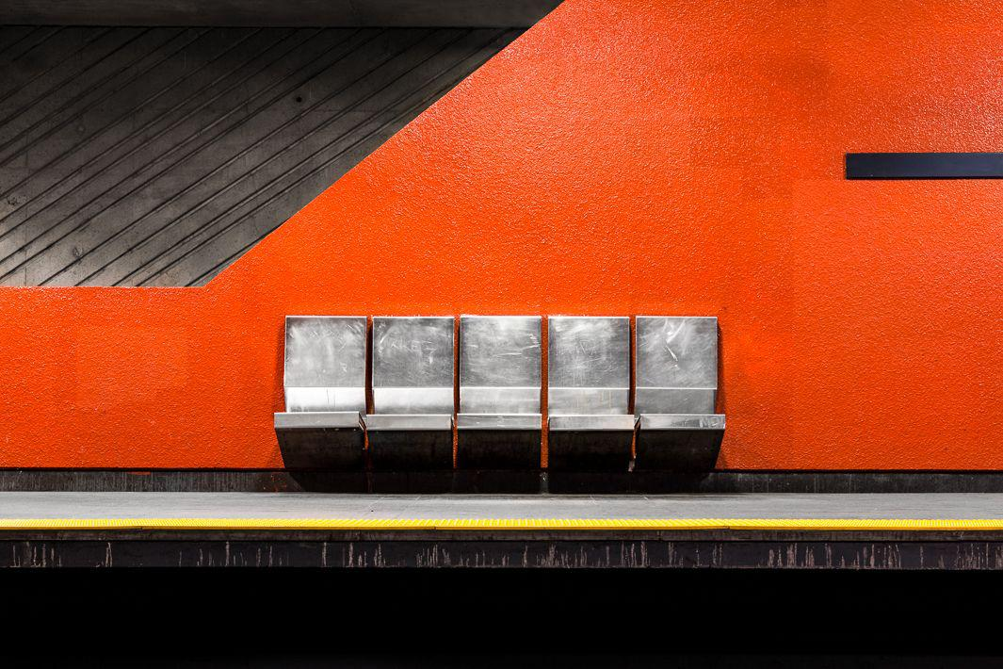
Future Analysis
Explore additional data available (i.e. analyze causes of interruptions)
Seasonal trends
Impact before and throughout COVID-19 pandemic

Slide 13
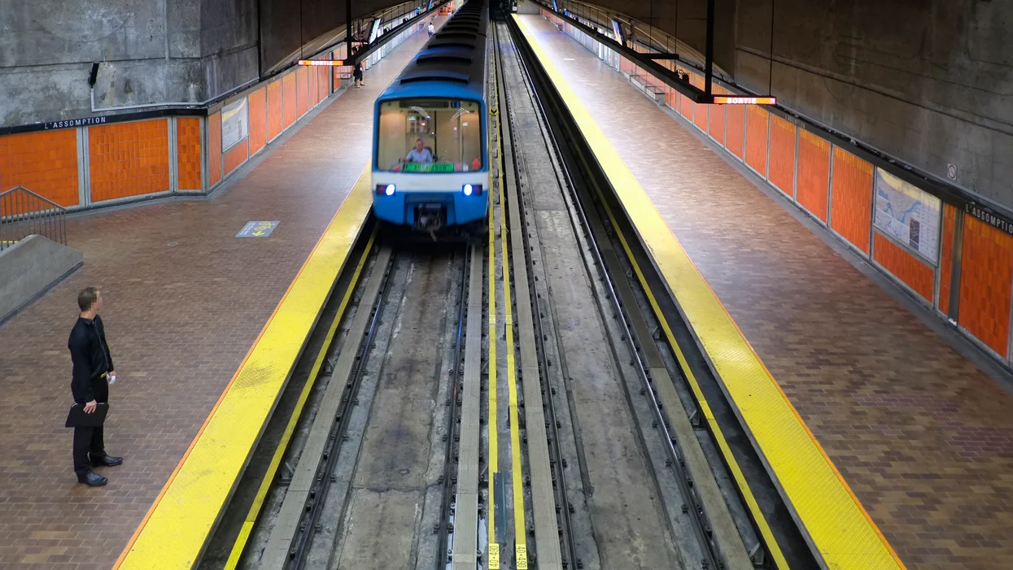
The end. Questions/comments?

